Slide 1
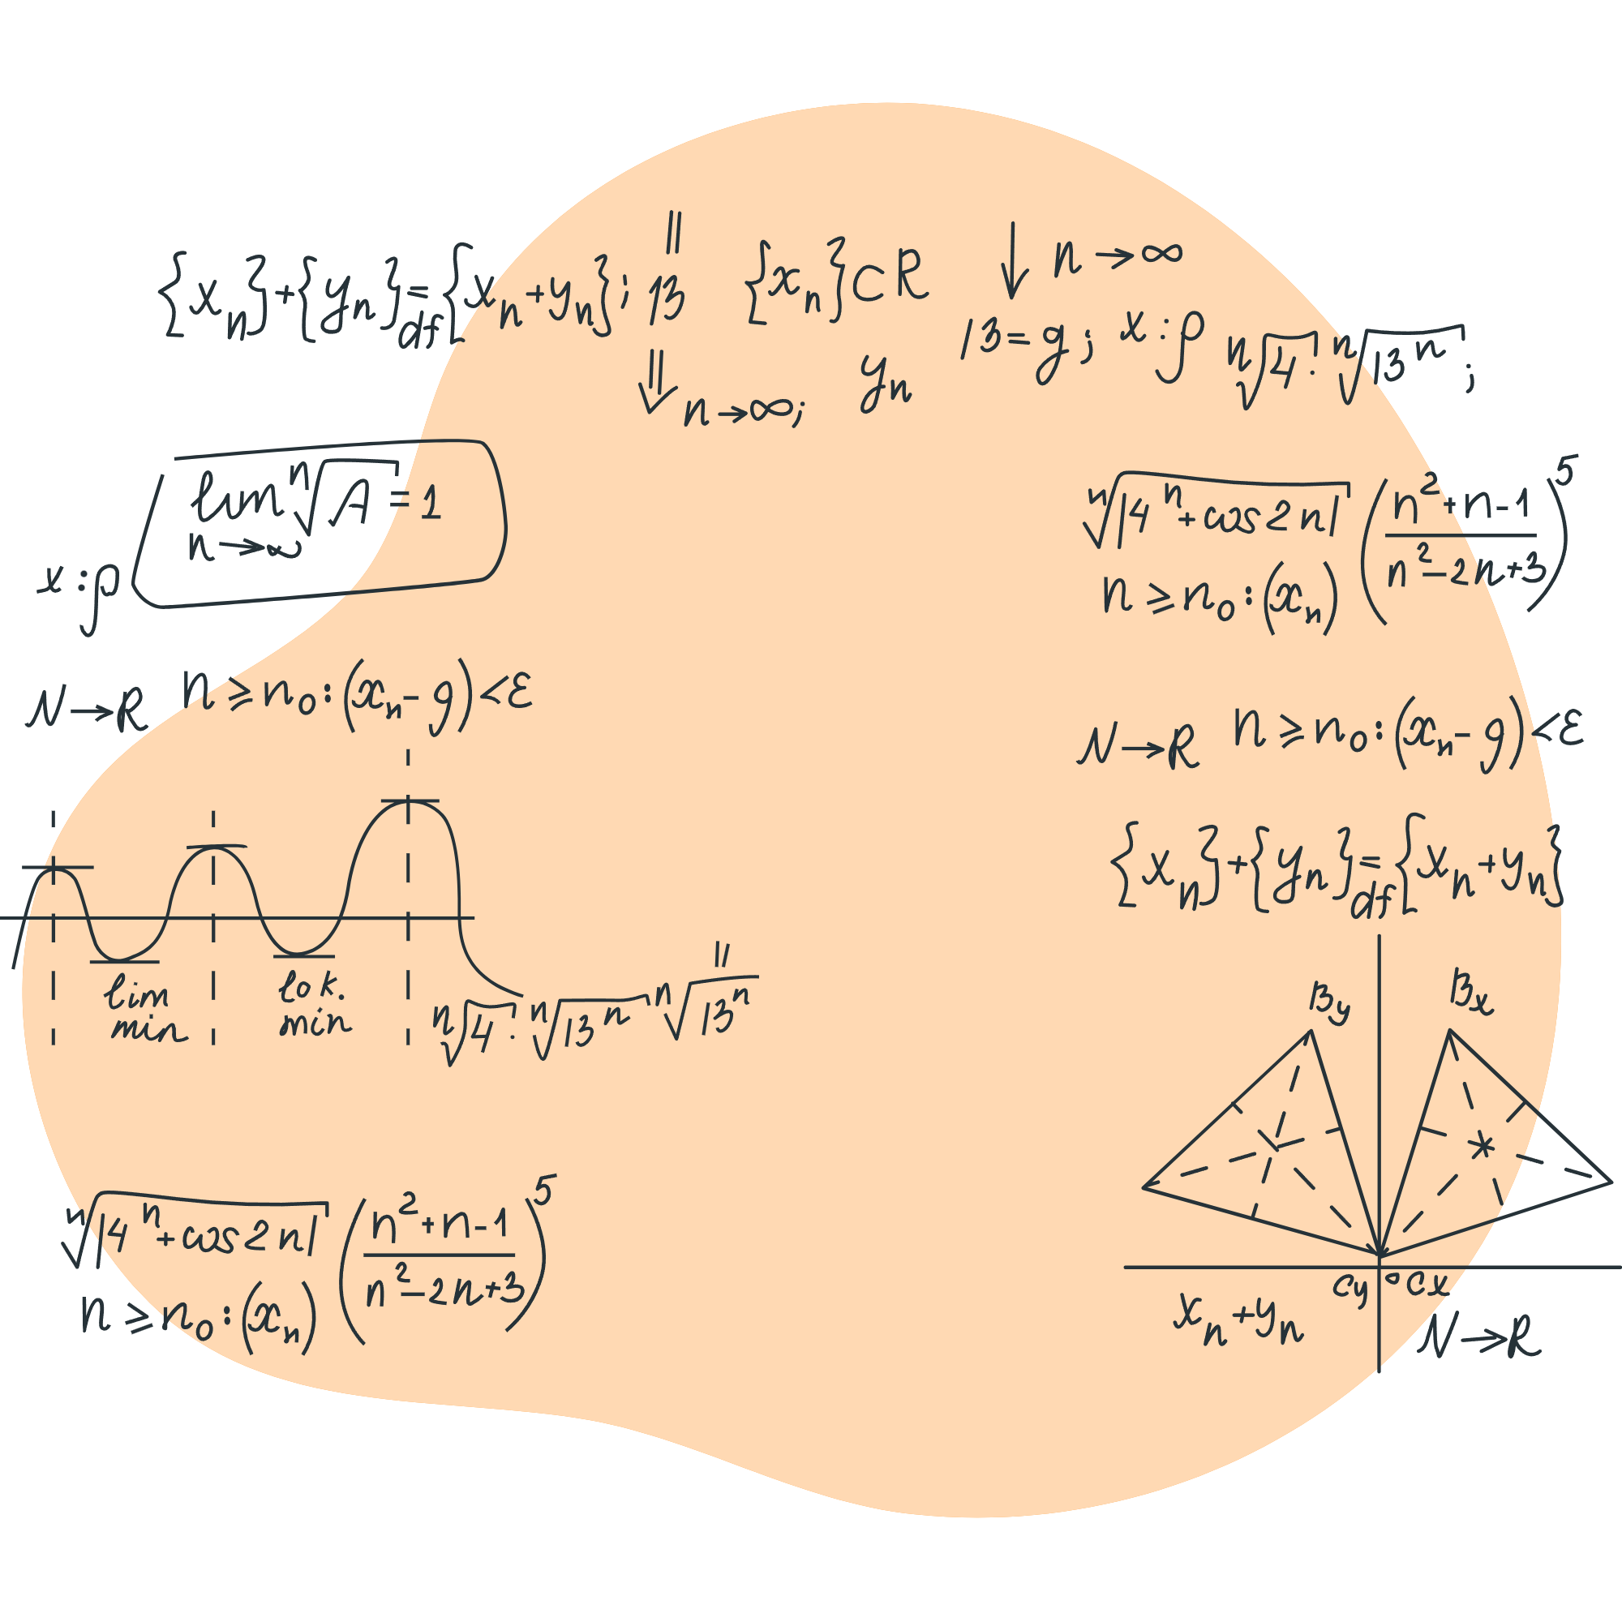
MathApps
Yasskin
Meade

Slide 2



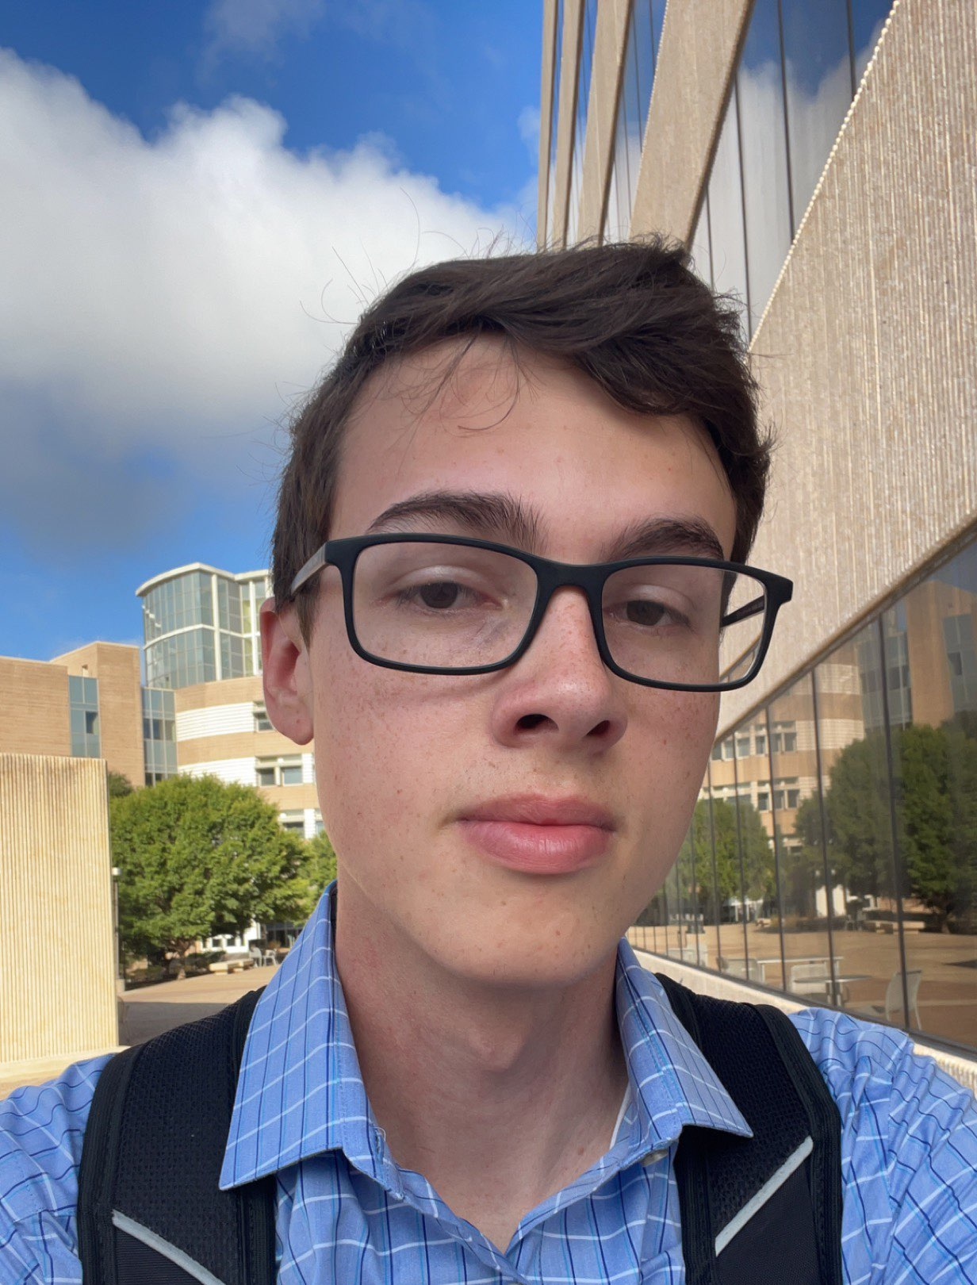
Our Team
Arunim Samudra
Nick Robert
Nikhil Nehra
Spencer Banasik
Handled Product Purchase and Subscription
Handled Instructor functionality
Handled Admin functionality
Handled User creation, editing, and validation

Slide 3

What we will cover
01
Goals and Objectives
02
Project Structure
03
Features
04
Database Structure
05
Challenges & Lessons
What we started with and what we planned to achieve
The tools we used to develop and communicate
The features we completed and their purpose
The entities and relationships used in our development
The problems we had and solutions we found most effective

Slide 4

Goals and Objectives
Starting Point
Goals
Basic pages and functionality present.
Missing instructor functionality.
Test cases were either not present or not passing.
Add functionality for instructors to give their students textbooks though the store.
Create a system for administrators to view, organize, and edit important information.
Refine previous functionality according to our sponsors requests.
Have test cases for back and front end with at least 90% coverage for unit tests.

Slide 5
Development Framework
Backend
Database
Nest.js
MySQL & Docker
Package Manager
Yarn
Testing Library
Frontend
Deployment
Cucumber & Jest
React
Heroku

Slide 6




Collaboration Tools
Github
Github Projects
Slack
Google Drive
Zoom
Version Control
Collaborative Coding
Feature Assignment
Progress Tracking
Team Communication
Sponsor Communication
Share Documents
Post Reports
Weekly Sponsor Meetings
Team Meetings

Slide 7
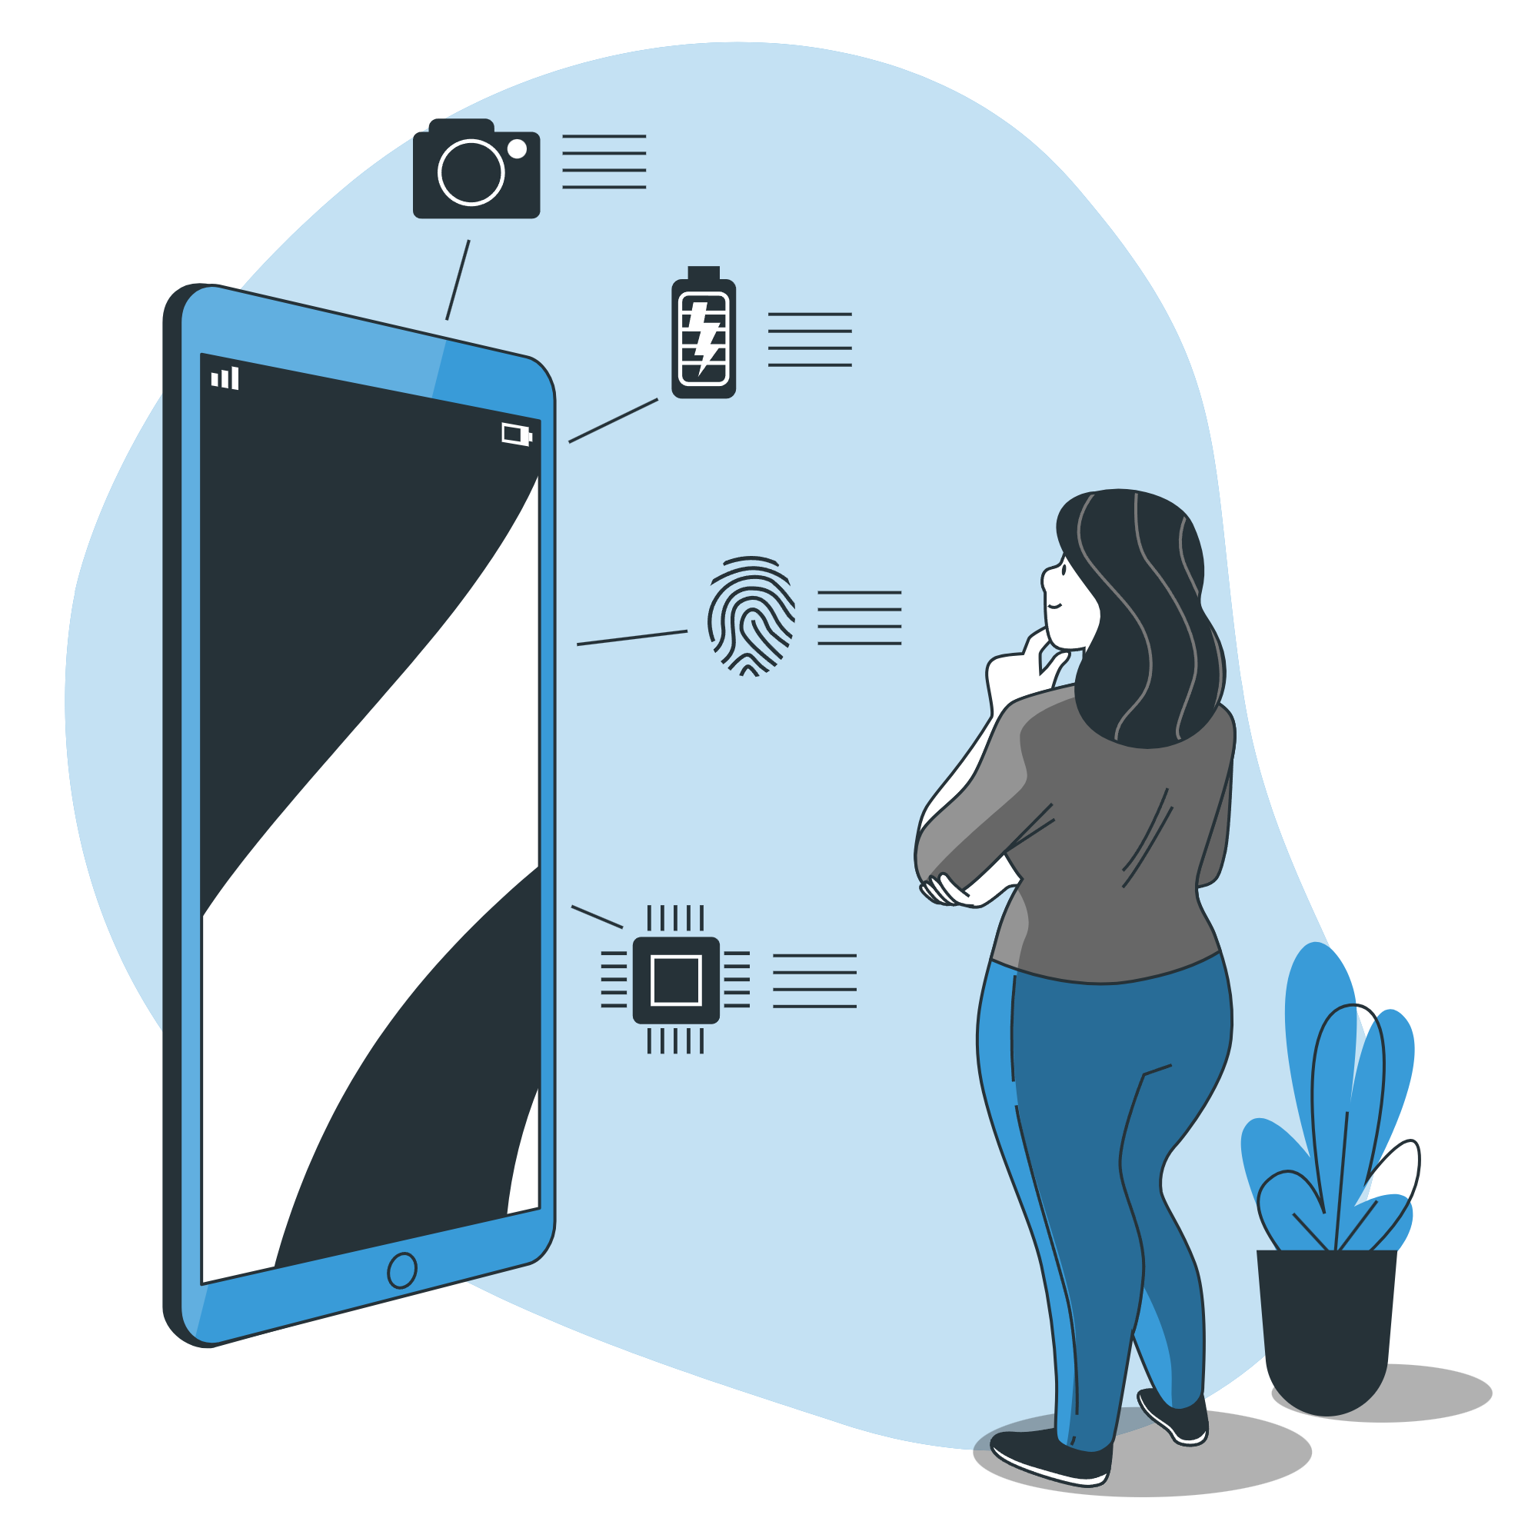
Features
User
Admin
Instructor
Change Profile First and Last Name
Change Password
Create Activation Email
Request Instructor Access
Pay with Credit Card
View Textbooks Offline (PDF)
Manage Transaction History
Manage Purchase Codes
Manage Users
Manage Classes
Manage Products
Manage Subscriptions
Manager Free Subscriptions Suffixes
Access Class Management
Purchase Textbook for the Class

Slide 8
Results
Tests
Passed
Unit Test Coverage
Planned Features Completed
98%
92%
90%

Slide 9
Database Structure
USER
User ID
First Name
Last Name
Email Address
Password Hash
Activated Account
Activation Code
Created At
Updated At
Role
Class ID
123
Free Subscription
Email Subscription ID
Suffix
ABC
Transaction
Transaction ID
Total
Created At
User ID
ABC
123
ABC
123
ABC
ABC
123
123
Transaction Detail
Transaction Detail ID
Final Price
Quantity
Item ID
Purchase Code Name
Transaction ID
Subscription
Subscription ID
Expiration Date
Item ID
Owner ID
User ID
ABC
123
123
123
Class
Class ID
InstructorID
123
123
123
123
123
123
123
123
123
123
Item
Item ID
Name
Price
Subscription Length
ABC
Purchase Code
Name
Sale Price
Item ID
123
123
ABC
ABC
123
123
123
123

Slide 10

Challenges & Lessons
Initial Development Environment
Initial Deployment
Understanding automated front-end testing
Understanding package manager
Allocation of Points for user stories
Importance of documentation

Slide 11

THANKS!
Do you have any questions?
Contact Us!
arunim_samudra@tamu.edu
nick_robert20@tamu.edu
nikhilnehra@tamu.edu
SMB200007@tamu.edu

Slide 12
RESOURCES
PHOTOS
<a href="https://storyset.com/technology">Technology illustrations by Storyset</a>
<a href="https://storyset.com/work">Work illustrations by Storyset</a>
<a href="https://storyset.com/work">Work illustrations by Storyset</a>
<a href="https://storyset.com/device">Device illustrations by Storyset</a>
<a href="https://storyset.com/people">People illustrations by Storyset</a>
<a href="https://storyset.com/online">Online illustrations by Storyset</a>
<a href="https://storyset.com/education">Education illustrations by Storyset</a>

